Slide 1

GROUP NO 11
Supervisor
INTRODUCTION
DESIGN
IMPLEMENTATION
TESTING
PROJECT TITLE
D
GROUP LEADER
Azaz Hassan Khan
GROUP MEMBER 1
Waqas Ahmed
GROUP MEMBER 2
Muhammad Harris
C
Efficient Low-latency Hardware Accelerator for High Frequency Trading Using FPGA.
Dr. Malik Umar Sharif
B
UNIVERSITY OF ENGINEERING AND TECHNOLOGY PESHWAR JALOZAI CAMPUS
A
FINAL YEAR PROJECT PROPOSAL

Slide 2
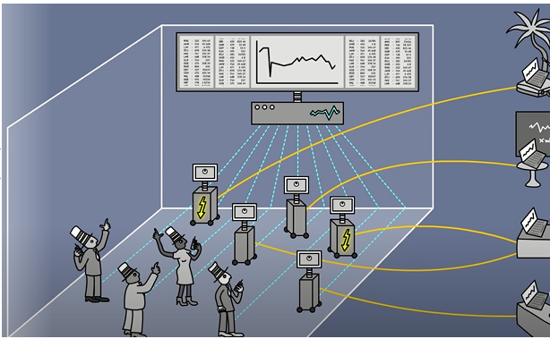
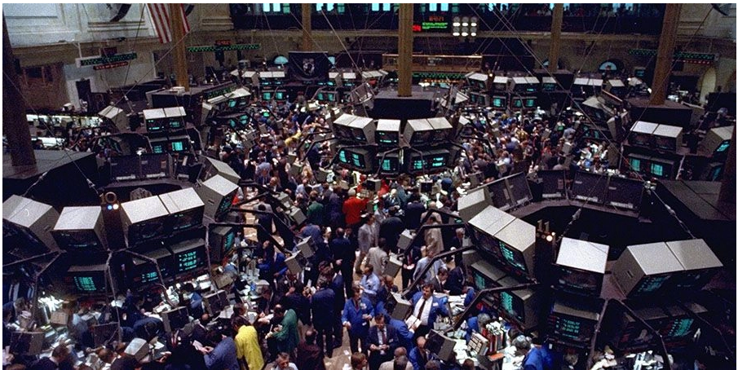
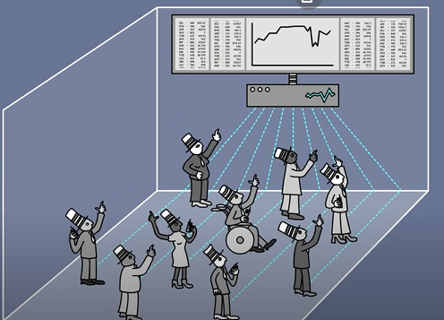
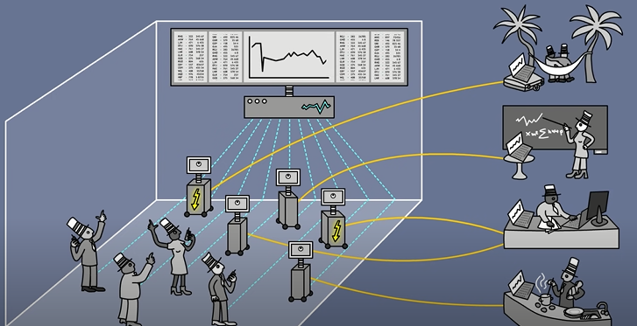
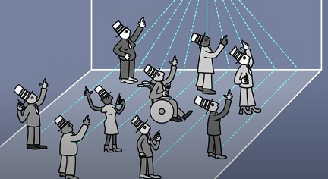
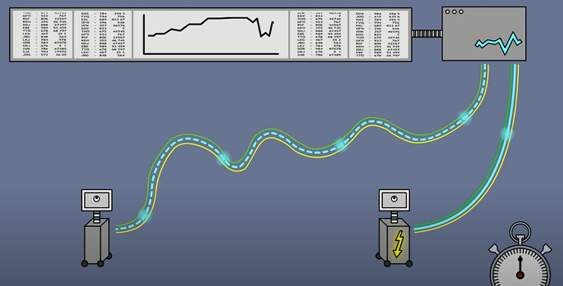
HIGH FREQUENCY TRADING
H1
ADVANTAGES
HIGH FREQUENCY TRADING
ADVANTAGES
H
OBJECTIVES
SKILL SET
OVERVIEW
INTRODUCTION
ALGORITHMIC TRADE
ALGORITHMIC TRADE
TRADING HISTORY
TRADING HISTORY
TRADING HISTORY
TRADING HISTORY
LATEST TECHNIQUES
G
HFT
LARGE WINS ON SMALL CHANGES
HIGH MARKET LIQUIDITY
EXPANDED OPPORTUNITIES
SKILL SET
C++
PYTHON
ML
CLOUD TECHNOLOGY
FPGA HARDWARE
API COMMUNICATION
VHDL
VIVADO SOFTWARE
ADVANTAGES
BETTER PRICES
IMPROVED ACCURACY
INCREASED SPEED
LOW TRANSACTION COST
F1
OVERVIEW
OBJECTIVES
Algorithm trading is also known as algo-trading.
It’s a trading solution that uses coded sets of algorithms and execution strategies to submit orders to a market or exchange automatically after a technical analysis.
Estimated US stock trade placed by computers is at about 75% and on the increase constantly.
Academic Objectives:
The goal of this project is to make algorithms for high frequency trading through Field Programmable Gate Array (FPGA). We have to achieve the profit and lowest possible latency for interpreting market data feeds and hence enable minimal round-trip times for executing electronic stock trades.
F
TRADING HISTORY
ALGORITHMIC TRADING
HIGH FREQUENCY TRADING
High-Frequency Trading which is a subset of algo-trading.
The core difference between them is that algorithmic trading is designed for the long-term, while high-frequency trading (HFT) allows one to buy and sell at a very fast rate.
The reason we shifted form AT to HFT is Speed.
Usually, the latency should be between 300 – 800 nanoseconds.
HIGH FREQUENCY TRADING
ALGORITMIC TRADING
E
D1
D
HOST
DECISIONS
STOCK MARKET API
DATA
C
B3
B2
B1
B
ELECTRONIC BULLITIN BOARD
A

Slide 3
TRADING SYSTEMS
COMPARISION BEWTEEN AI AND MACHINE LEARNING
TRADING ALGORITHM
G
CLOUD COMPUTING
ALGORITHM
DESIGN
DATA ORGANIZING
DATA EXTRACTION
CLOUD COMPUTING
SAVE ELECTRICITY
NO INTERNET CONNECTION NEEDED
SECURITY
NO INTERPTION
EASY ACCESS
FPGA
TRADING
PYTHON
F
TRADING ALGORITHMS
TRADITIONAL AI BASED
MACHINE LEARNING BASED
TRADING SYSTEMS
VECTORIZED BASED
EVENT DRIVEN BASED
DATA EXTRACTING
DATA ORGANIZING
TRADING ALGORITHM
CLOUD BASED COMPUTING
VHDL TRADING ALGORITHM FOR FPGA
HOST
BROKER
MACHINE LEARNING
AI BASED
TRADING RULES
CODE
OUTPUT
INPUT FEATURES
OUTPUT
TRADING RULES
DATA SORTING
DATA CLEANING
DATA FRAME
E
D
REQUEST DATA
SENT DATA
C
B
A

Slide 4
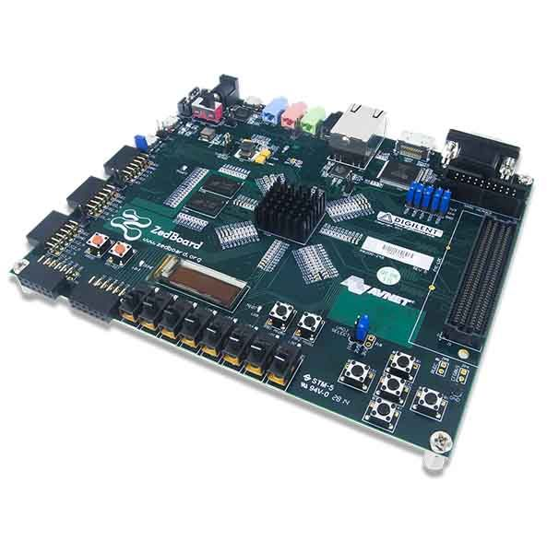
FPGA DEVELOPMENT BOARD

Slide 5
ALGORITHM
IMPLEMENTATION
HISTORICAL DATA
REAL TIME DATA
DATA EXTRACTOR ON DUKASCOPY BANK
DATA ORGANIZER ON HISTORICAL EXTRACTED DATA
IMPLEMENTING TRADING ALGORITHMS ON HISTORICAL DATA
IMPLEMENTING TRADING ALGORITHMS ON REAL TIME DATA
IMPLEMENTING VHDL TRADING ALGORITHMS ON FPGA BOARD
A

Slide 6
ALGORITHM
TESTING
UNIT TESTING
CORRELATION TESTING
ALGORITHMS TESTING
TESTING DATA EXTRATOR
TESTING DATA ORGANIZER
TESTING TRADITIONAL ALGORITHMS
TESTING MACHINE LEARNING ALGORITHMS
TESTING EVENT DRIVEN ALGORITHMS
TESTING VHDL ALGORITHMS ON FPGA DEVELOPMENT BOARD
A

Slide 7
Distribution of work:
TASK | Azaz Hassan Khan | Waqas Ahmed | Harris
Do the Literature Survey.
Data Mining for Stock market Prices by API’s.
Designing Traditional Algorithmic Trading Decision Making techniques in vectorized form.
Testing Traditional Algorithmic Trading Decision Making techniques on stock market data.
Designing Stock market Predication based Machine Learning techniques in vectorized form.
Testing Stock market Predication based Machine Learning techniques on stock market data.
Converting Algorithmic Code from Vectorized form to Event driven form.
Make the entire Trading Algorithm Cloud Based.
Back test in real time on stock market Prices.
Implementing Profitable Trading algorithms on FPGA.
Testing the final work
Publication of paper
Write the Proposal
Write the Monthly Reports
Write the Progress Report
Write the Final Report
Prepare for the Presentation
Design the Project Poster.

Slide 8
References
[1] Peter Gomber, Björn Arndt, Marco Lutat, Tim Uhl book “High-Frequency Trading”
Germany, 2010.
[2] A. S. Gillis, "TechTarget," 24, November 2021. [Online]. Available:
www.velvetech.com/blog/high-frequency-algorithmic-trading/
[3] J.A. Brogaard, “High Frequency Trading and its Impact on Market Quality,” 5th Annual
Conference on Empirical Legal Studies, 2010.
[4] M. Chlistalla, “High-frequency trading Better than its reputation?” Deutsche Bank
research report, 2011.
[5] A. Group, New World Order, “The High Frequency Trading Community and Its Impact
on Market Structure”, 2009.
[6] Yves Hilpisch ,”Python for Algorithmic Trading” First Edition, November 2020

Slide 9
THANKS FOR WATCHING

